Slide 1


Chicago Crime Analysis Part II
By Sai Vinay Pabbisetty

Slide 2
Literature Review
Literature References:
Varan, Shyam. (2007). Crime Pattern Detection Using Data Mining. 41 - 44. 10.1109/WI-IATW.2006.55.
X. Zhang, Z. Hu, R. Li and Z. Zheng, "Detecting and mapping crime hot spots based on improved attribute oriented induce clustering," 2010 18th International Conference on Geoinformatics, Beijing, 2010
Nathan Holt, Analyzing Crime in Chicago Through Machine Learning, ,Unpublished
Review:
Crime is one of the prevailing and concerning facet in any society. The increase in crime rates is one of the cause for the alarm. Law enforcement agencies, intelligence agencies and police maintain crime databases.
The crime data can be analyzed to gain insights and to extract knowledge from it. Several studies have discovered number of techniques to analyze the crime data. The crime data analysis can provide the crime statistics of a region, country or world.
The law enforcement agencies can take better decisions for prosperity of the citizens by understanding the various parameters that influence the crimes.
There are some existing tools and softwares that are being used by police like Hunchlab, COPLINK by IBM and Accurint Crime Analysis which are based on risk terrain modeling by using several data pointers like location, description of crime etc.
In my Project, I will try applying new algorithms and techniques for the crime analysis and predictive policing & patrolling and see how the results differ when compared to the existing tools and softwares.

Slide 3
Data Pre-processing
Handling Null values
01
Dropping(or Will drop) Unnecessary columns [As per the requirement for my future data modelling]
02
Checking for Missing values and making sure the data is ready for the analysis
03

Slide 4
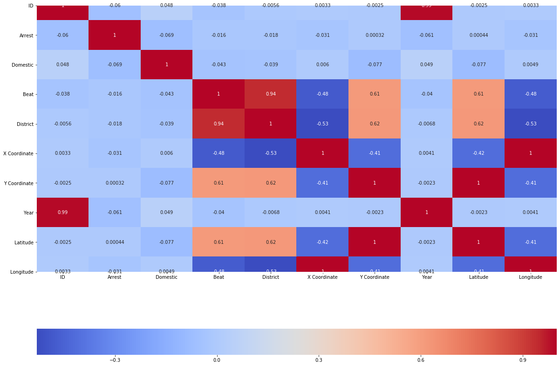
Correlation heat map

Slide 5
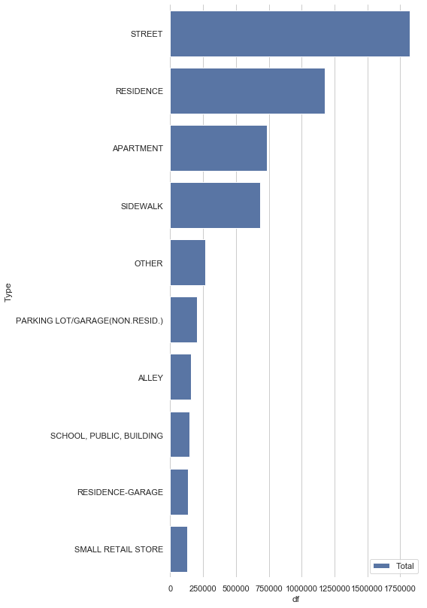
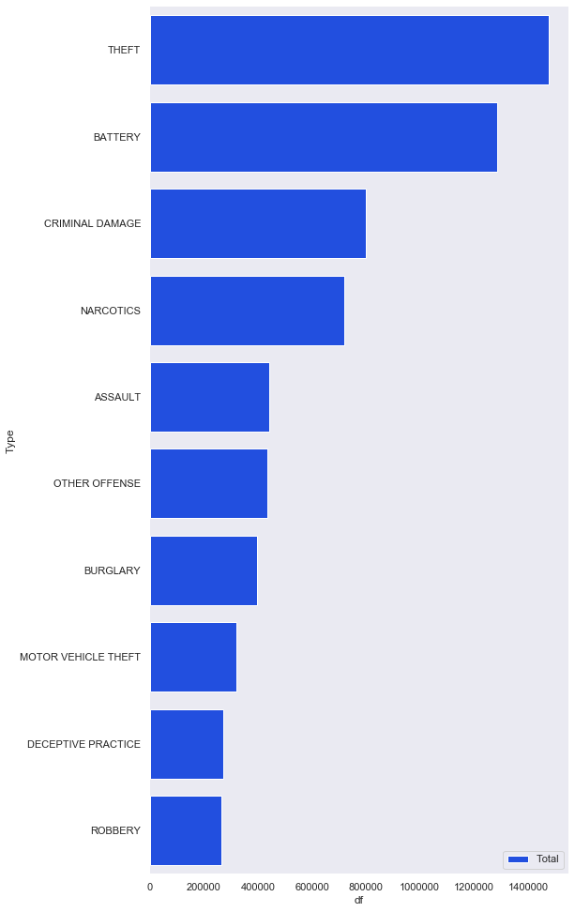
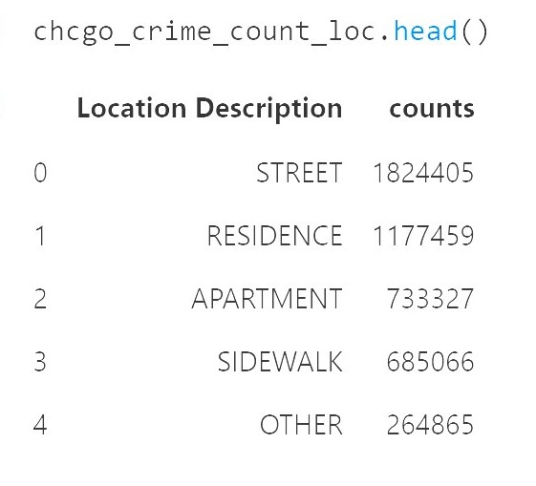
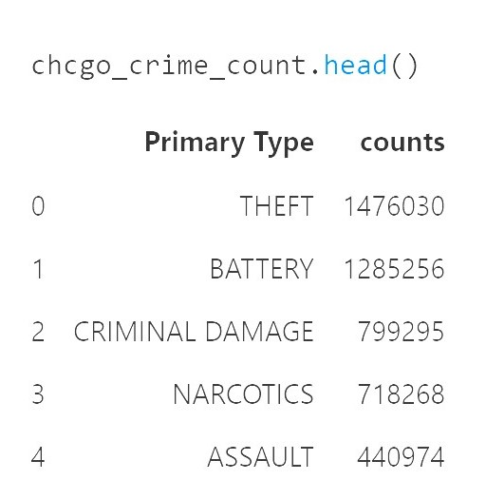
MOST FREQUENT CRIME LOCATIONS MOST FREQUENT CRIMES
EDA

Slide 6
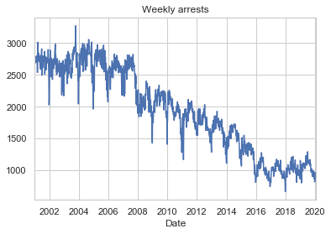
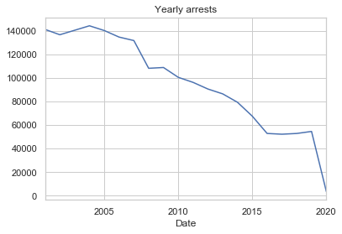
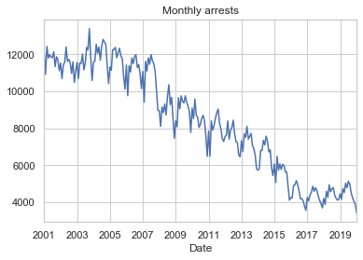
EDA

Slide 7

Thank You

